Slide 1
ATE(Automated Testing Equipment) Drift Prediction
Yating Chang, Wei-Hsiang Chu, Cheng-Hao Tsai University of California, Davis – EEC256 Project Report

Slide 2
Goal of the Project
Option 2
Project Goal: To develop a reinforcement learning–based system that can proactively detect and correct ATE sensor drift in semiconductor testing, with the objective of:
Minimizing test cost
Reducing false fails
Maintaining yield stability

Slide 3
Motivation
ATE performance gradually drifts over time in high-volume manufacturing
Calibration done too early = wasted time and cost
Calibration done too late = test errors and misclassified chips
We propose an RL-based approach to learn when to calibrate, adaptively

Slide 4
Method Overview
ATE Environment Modeling
Chip Generating Model
Double Q-Learning Training

Slide 5
ATE Environment Modeling
We model the ATE drift correction problem as a Markov Decision Process (MDP):
Element | In Our Project
State | State was defined by features such as the current drift.
Action | 0 = do nothing, 1 = calibrate
Reward | +10 (recalibrate Drift within range 50~100), -20 (recalibrate without range)
Transition | Drift happens at step 37 in simulation
γ (gamma) | 1 — prefers long-term yield benefit

Slide 6
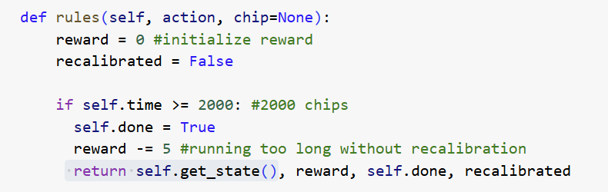
Chip Generating Model
Purpose: To provide a realistic stream of test measurements, we built a chip-generating model. This simulates the variety of chip outputs that the ATE would measure.
Chip Parameter Distribution: We assumed a known distribution for the chip’s true values.
Measured Value Calculation: When a chip is tested by the ATE, the measured value = true value + drift + noise.
- Drift: The current drift offset in the ATE.
- Noise: A random measurement noise term is added to simulate sensor noise (zero-mean noise).
Agent Observations: We might provide the drift value directly to the agent state for easier learning.

Slide 7
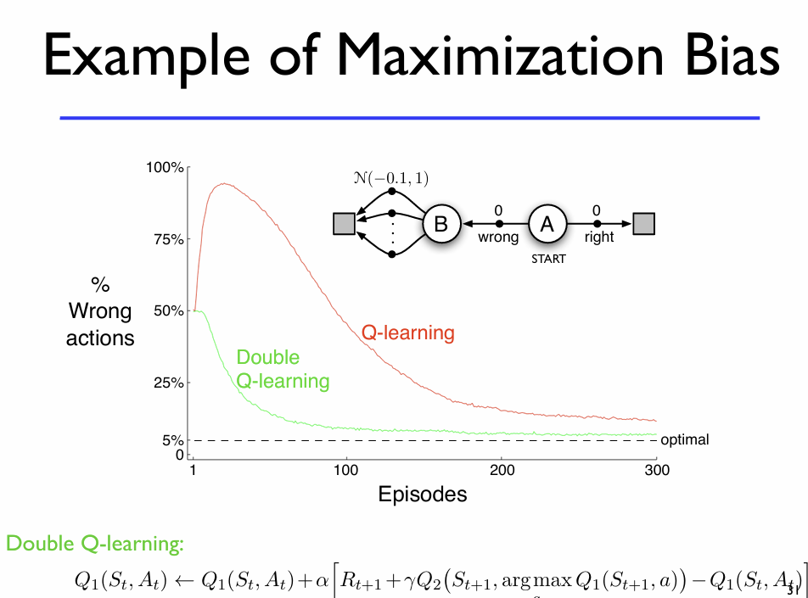
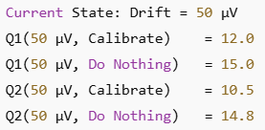

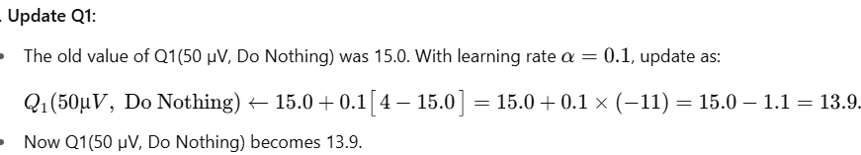
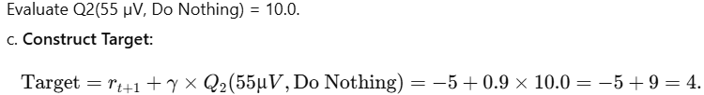
Double Q-Learning Training
“Calibrate” sum = 12.0 + 10.5 = 22.5
“Do Nothing” sum = 15.0 + 14.8 = 29.8
Step1
Step 2
→ Drift increases from 50 µV to 55 µv and reward -5.
Step 3
Step 4
When to stop updated Q learning:
Convergence Criteria:
1. Monitor Cumulative reward trend
2. Observe Q-value Stability:
If their changes become negligible, they have effectively converged.
3. Maximum Episode Cutoff

Slide 8
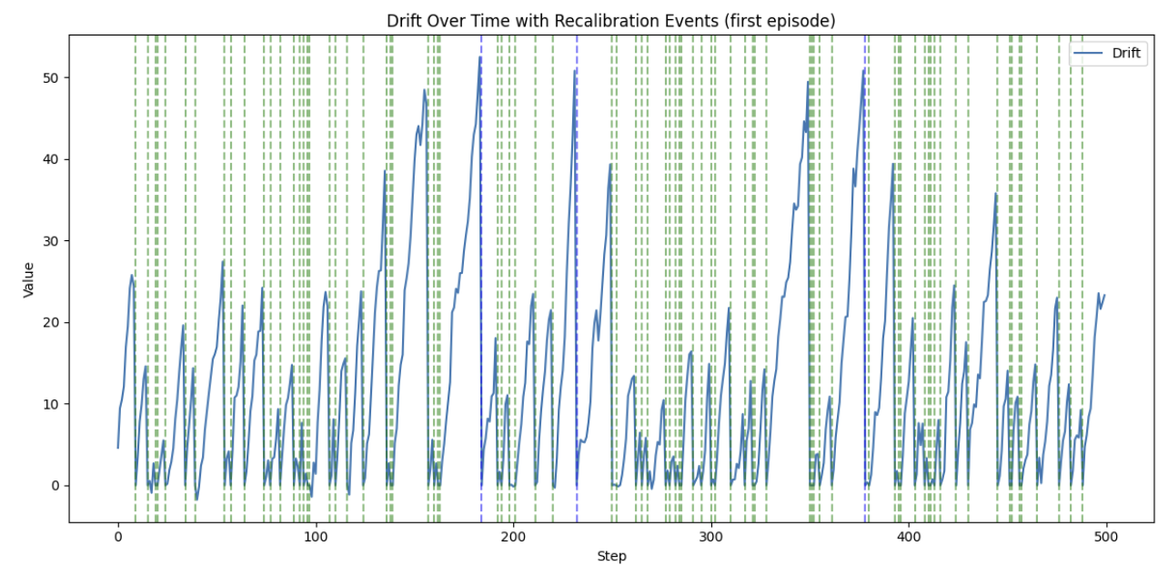
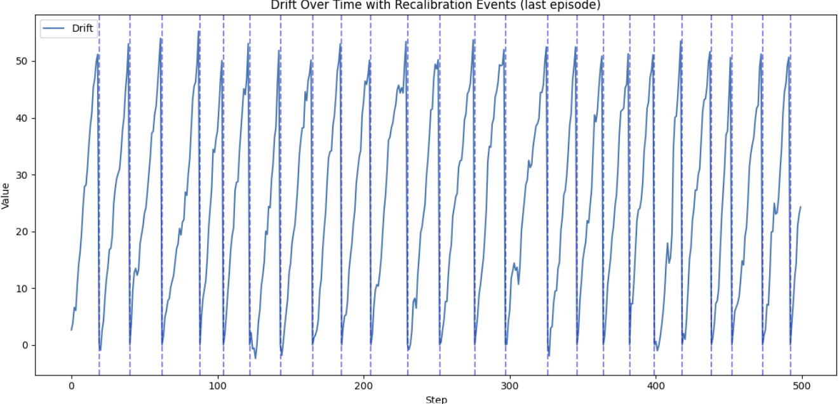
Model Testing of Result
RL model:
Recalibration Frequency / Cost: How often the agent performs recalibration. A lower frequency means less downtime, but it's a trade-off between error and recalibration frequency.
Cumulative Reward: The total reward achieved in the testing episodes.
Product Yield/Accuracy: Product yield and accuracy tend to be higher when an agent effectively keeps drift low and recalibrates at the right time.
Baseline Comparisons: We compared the RL agent’s performance against baseline strategy:
Always select to keep testing as the next action
No recalibration

Slide 9


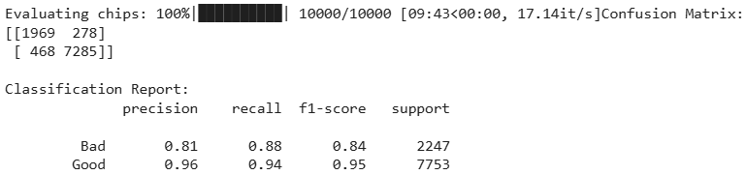
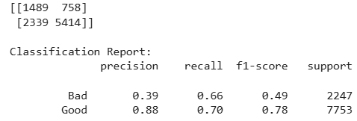
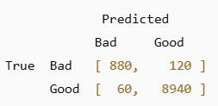
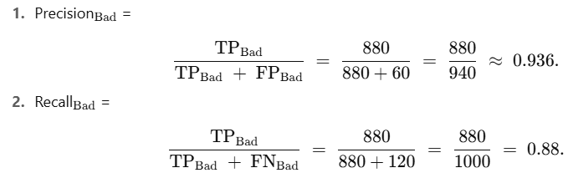
Discussion of result
RL model
Baseline
Set example:

Slide 10
Team Collaboration
Team Member | Responsibility
Yating Chang | Project idea, ATE simulation, RL design
Wei-Hsiang Chu | Double Q-learning implementation, training setup
Cheng-Hao Tsai | Integration, testing, and visualization

Slide 11
Thank you for your listening

